Slide 1

The SP500 Effect: Analyzing the Relationship of Tesla, Apple, and Microsoft with Stock Prices
Data Science Internship | Oeson Learning
Project by: Khaldoun Bou Hadir

Slide 2
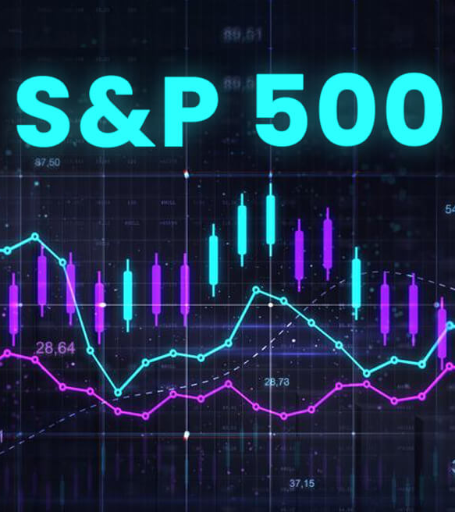
1. Introduction: The significance of SP500 in stock market
The S&P 500 is a critical benchmark for understanding the health of the U.S. stock market. It tracks the performance of the 500 largest publicly traded companies in the country, giving a broad perspective on how major American businesses are faring. Because these companies are industry leaders, the S&P 500 is seen as a strong indicator of the overall economy's condition. Investors often use the index's performance to gauge their own portfolios and make investment decisions.

Slide 4

2. Overview of Tesla's performance on SP500
Tesla (TSLA) was a major force in the S&P 500. News articles discuss it being a part of the prestigious "Magnificent Seven" top performers . Its stock price soared, likely due to factors like investor enthusiasm for electric vehicles and Elon Musk's leadership

Slide 6

3. Apple's position in SP500 and its impact on stock prices
Apple has been a significant force within the S&P 500 for years. As a major holding due to its large market capitalization, Apple's performance directly impacts the index's movement. Apple's role in the S&P 500 has been substantial, acting as a growth driver and significantly impacting the index's performance.

Slide 8
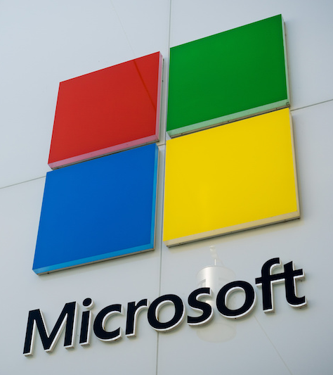
4. Microsoft's inclusion in SP500 and its influence on stock prices
Microsoft (MSFT) has been a significant force in the S&P 500 for years, consistently ranking among the top performers. In the period leading up to 2024, Microsoft was part of a group of tech giants nicknamed the "Magnificent 7" due to their exceptional growth. While the S&P 500 struggled in 2022, Microsoft, along with others in the Magnificent 7, bucked the trend and delivered strong returns. This impressive performance continued into 2023, with Microsoft benefiting from the surge in interest surrounding Artificial Intelligence (AI). Experts anticipated this momentum to carry over into 2024, fueled by Microsoft's continued investment in AI technologies. Microsoft's consistent growth and leadership in the tech sector solidify its position as a key player within the S&P 500.

Slide 10
5. Comparative analysis of Tesla, Apple, and Microsoft within SP500
To gain a comprehensive understanding of the SP500 effect, we need to analyze the relationship between Tesla, Apple, and Microsoft with stock prices. By comparing their performance within the SP500 index, we can identify patterns and trends that will aid investors in developing effective investment strategies. This analysis will help investors capitalize on opportunities and mitigate risks in the ever-changing stock market landscape especially by making a regression model over the percentage change in stock with respect to that of SP500.

Slide 11
The percentage changes, whether positive or negative, in the stock prices of
Apple, Tesla, and Microsoft tend to be closely aligned with the movements of the S&P 500.

